Slide 1




MAT 102
Differential Equations and Special Functions
Jannatul Haq Nayeem
2018-1-60-224
Akhi Alam
2019-1-50-057
MD. Sadimur Rahman
2016-1-39-023

Slide 2
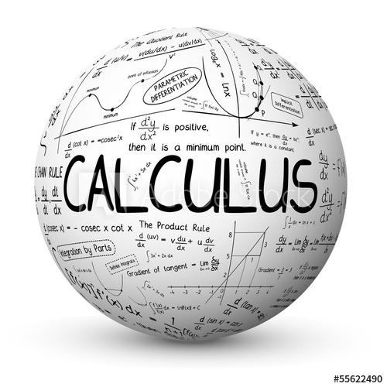
Applications of First Order
Differential Equation

Slide 3
Definition of First Order Differential Equation
A differential equation involving derivatives of one or more dependent variables with respect to a single independent variable and which has only one order derivatives, is called a first order differential equation.

Slide 4
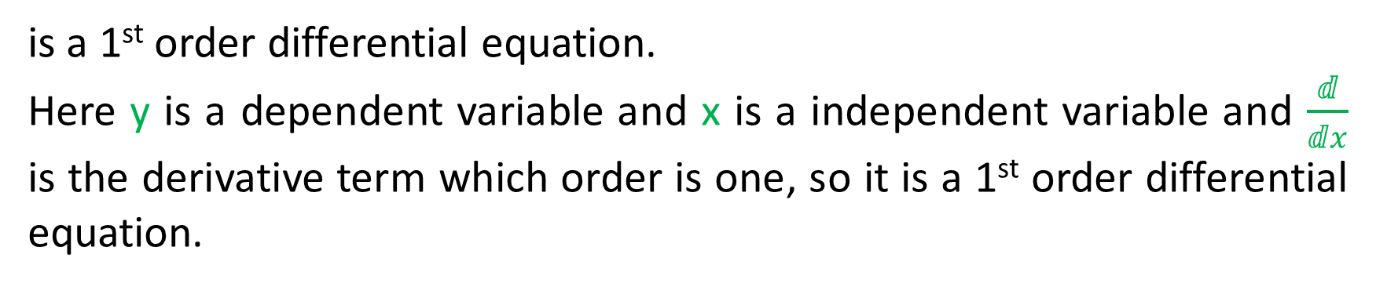
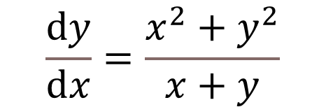
Example
$$\frac{ⅆy}{ⅆx}=\frac{x^{2}+y^{2}}{x+y}$$
is a 1st order differential equation.
Here y is a dependent variable and x is a independent variable and $\frac{ⅆ}{ⅆx}$ is the derivative term which order is one, so it is a 1st order differential equation.

Slide 5
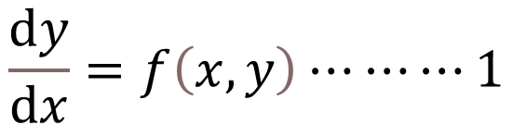
Standard Form of 1st Order Ordinary Differential Equation
$$\frac{ⅆy}{ⅆx}=f\left(x,y\right)⋯⋯⋯1$$
Or the differential form
$$M\left(x,y\right)ⅆx+N\left(x,y\right)ⅆy=0………2$$

Slide 6
Application of 1st Order Differential Equation
There are a lot of applications of 1st order ordinary differential
equation in our real life in various sectors. Now we will see some
of these applications.

Slide 7
1
Cooling/Warming Law (use in physics)
2
Population Growth and Decay (in statistics)
Radio Active Decay and Carbon Dating
3
Series Circuits (in physics)
4
Survivability with AIDS (in medicine)
5
Draining a tank (in engineering)
6
7
Determination of curves that have certain geometrical properties
And so on……

Slide 8
Let's see some applications of 1st order
differential equation with example.

Slide 9
Population Growth and Decay (in statistics)
Problem: A population grows at the rate of 5% per year. How long does it take for the population to double?
Solution: Let the initial population be and let the population after t years be p. Then we get

Slide 10
which is a separable differential equation. Now we integrating (1) and we get,

Slide 11
Determination of curves that have certain geometrical properties
Problem: The slope of the tangent at a point (x, y) on a curve is
(− 𝑥 /𝑦 ). If the curve passes through the point (3,-4). Find the equation of the curve.
Solution: We know the slope of a curve at point (x, y) is

Slide 13
Thank You

